Slide 1
Experiments in Synthetic data generation and predictive power
Industry Practicum – Purdue University

Slide 2





Our Team
Naveen Shaji
Amisha Turkel
Pratik Kamat
Anusha Reddy
Prashanth Suresh

Slide 3




Understanding Synthetic Data
What is Synthetic data ?
What is the Benefit?
Artificially generated data designed to mimic the properties of real-world data
Ensures privacy and confidentiality of customers, making it easier to share data across subsidiaries

Slide 4
Synthetic Data – Definition and Benefit
What is Synthetic Data ?
What is the Benefit?
Artificially generated data designed to mimic the properties of real-world data
May be generated using
Simple Rules | Statistical Modelling | Simulation
Overcomes real data restrictions:
To improve data privacy and confidentiality
To simulate edge cases
To fix class imbalance

Slide 5


Business Problem
Client uses a logistic regression model to identify inbounds from an affiliate having high probability of purchasing their offerings
Logistic Regression
Currently this model uses sensitive customer membership and transaction history data
Objective: Explore the viability of synthetic data as a substitute for real data in this solution

Slide 6



Dimensions of Synthetic Data Evaluation
Information Captured
Predictive Utility
Data Privacy
Synthetic Data generated must capture relevant information from original data
Synthetic data must provide satisfactory predictive power
Synthetic data must protect sensitive information

Slide 7
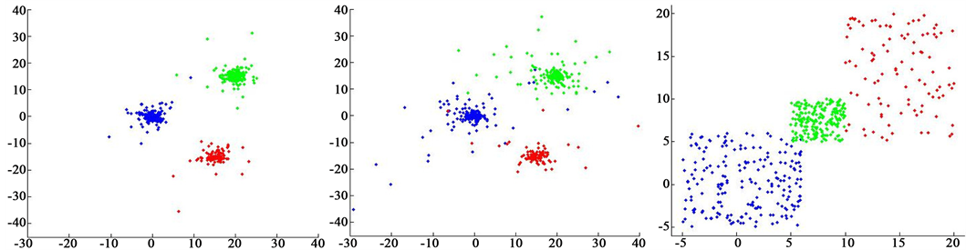
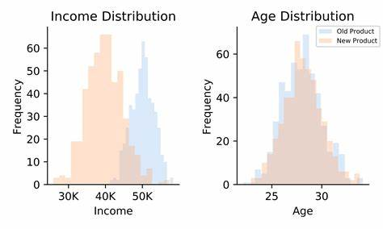
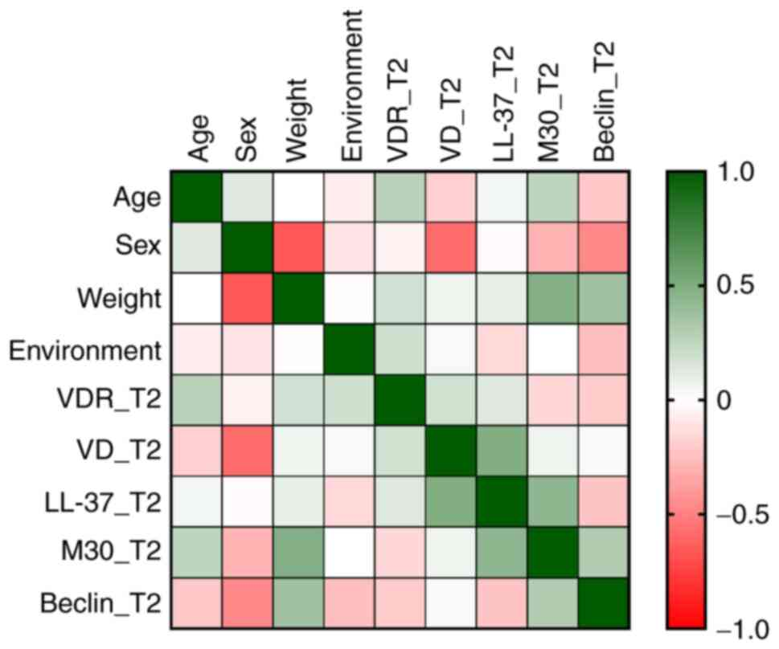
Information Captured by Synthetic Data
Synthetic data generated must capture relevant information from original data
Cluster Comparison
Data Distribution
Correlation Comparison
Clusters formed by synthetic data must be similar to real data clusters
Univariate data distributions must be similar
Correlations amongst features must be similar
Real
Data
Synthetic
Data
Real vs Synthetic Distribution
Real vs Synthetic Correlation Similarity
Overview of information captured
Information captured for every feature
Mutual information captured

Slide 8
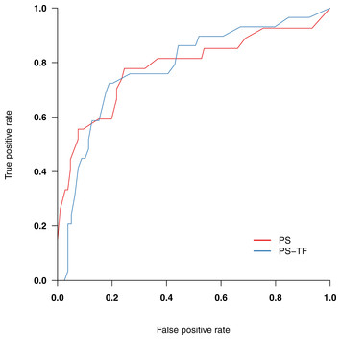
Predictive Utility
Synthetic data must provide satisfactory predictive power
For the same model, how well does the synthetic data classify compared to real data
Logistic
Regression
ROC
Score
Metric to compare classification performance
Model used for comparison

Slide 9


Data Privacy
Synthetic data must protect sensitive information
If we pick a customer record from synthetic data, what is the probability of there being a similar customer in the real data
Real Customer
Synthetic Customer
Membership Tenure | 5.3 years
Resort Location | Hawaii
Inbound Product | Rental
Confirmations 5Y | 12
Membership Tenure | 5.2 years
Resort Location | Hawaii
Inbound Product | Rental
Confirmations 5Y | 13
High Similarity

Slide 10

Solution Workflow
Information Capture
Cluster Comparison
Data Distribution
Correlations
Synthetic Data Generation
Model Utility
DataSynthesizer
ROC
Logistic Regression
Real Data
Multiple iterations with increasing noise to increase privacy
Trade-off
Assessment
Gaussian Copula
CTGAN
Data Privacy
Approximate Nearest Neighbours

Slide 11
Data Description and Business Constraints
Data Overview
Business Constraints
Membership Information and Transactions History
Used to predict likelihood of conversion
Affiliate Confirmations 5Y
Can not be greater than
Confirmations 5Y
Exchanges 3Y
High Class Imbalance
Fewer records for converted customers
Actual Confirmations 5Y
Is 0 when
Confirmations 5Y
Outlier Treatment and Derived columns present for confirmations
Is less than 19
Derived Columns and Outlier Capping

Slide 12
Synthetic Data Generation
DataSynthesizer

Slide 13
About DataSynthesizer
Bayesian Network based on GreedyBayes, maximizing Mutual Information
Data Synthesizer
Network with 2 parents
Actual Confirmation 5Y
Data Describer
Ownership Segment
Confirmation 5Y
Data Generator
Inbound Product
Independent Attribute Mode
Correlated Attribute Mode
Data Describer constructs a Bayesian network based on marginal probability and conditional probabilities
Data Generator generates synthetic data based on sampling values from root node
Exchanges 3Y
WVR Confirmation 5Y

Slide 14
About DataSynthesizer
Bayesian Network based on GreedyBayes, maximizing Mutual Information
Network with 2 parents
Actual Confirmation 5Y
Actual Confirmation 5Y
Construct a Bayesian network based on marginal probability and conditional probabilities
Generates synthetic data based on sampling values starting from root node
Ownership Segment
Confirmation 5Y
Inbound Product
Exchanges 3Y
WVR Confirmation 5Y

Slide 15
About DataSynthesizer
Bayesian Network based on GreedyBayes, maximizing Mutual Information
Data Synthesizer
Network with 2 parents
Actual_Confirmation 5Y | Probability
0 | 0.837
1 | 0.163
Actual Confirmation 5Y
Data Describer
Ownership Segment
Confirmation 5Y
Ownership Segment | Actual Confirmation 5Y=0 | Actual Confirmation 5Y=1
C | 0.190984 | 0.003251
CP | 0.001609 | 0.009886
CPW | 0.001293 | 0.003794
CW | 0.011508 | 0.008482
O | 0.01651 | 0.952984
Independent Attribute Mode
Correlated Attribute Mode
Data Describer constructs a Bayesian network based on marginal probability and conditional probabilities
Inbound Product
Exchanges 3Y
WVR Confirmation 5Y
Data Generator generates synthetic data based on sampling values from each node

Slide 16
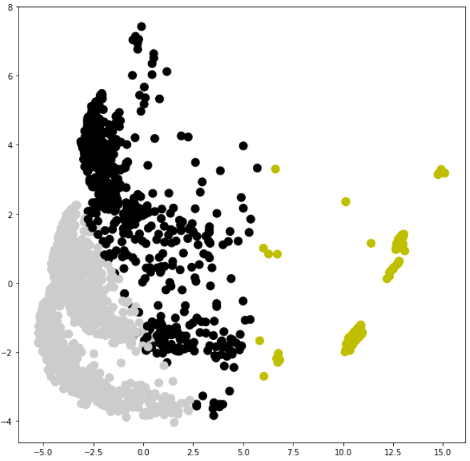
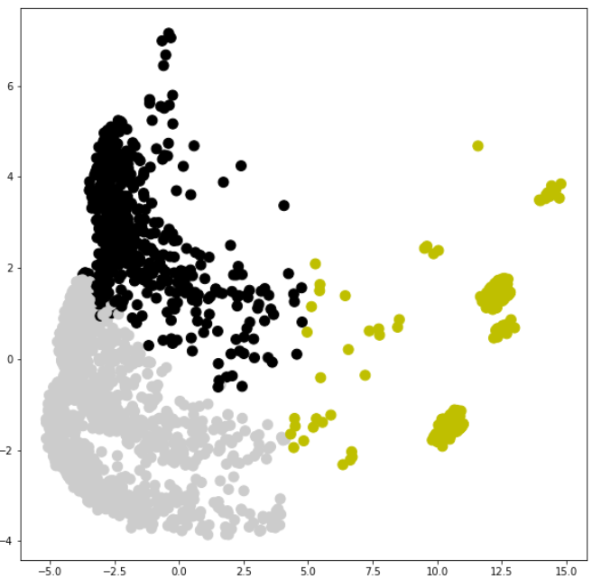
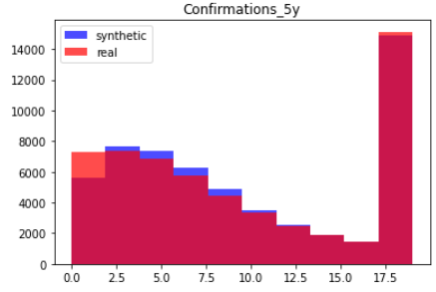
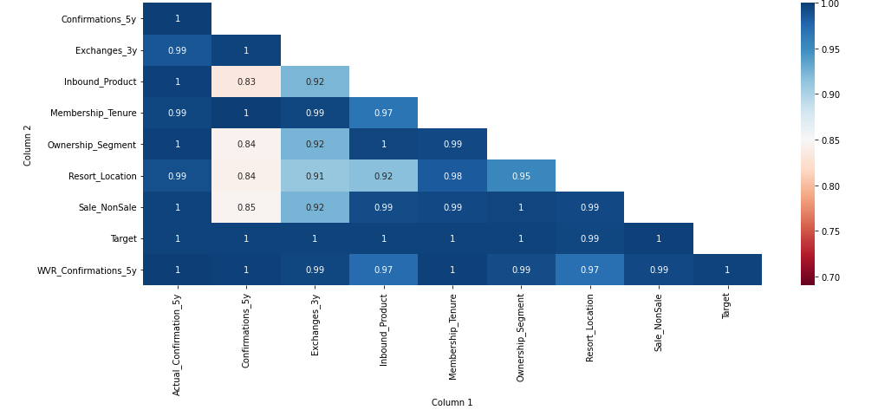
Effectively Captures Relevant Information
Cluster Comparison
Data Distribution
Correlation Comparison
Correlation Similarity
Real Data
Synthetic Data
Real vs Synthetic Distribution
Real vs Synthetic Correlation Similarity
Similar clusters formed
Similar Univariate distributions
Overall Similarity: 97%
Similar Correlations
Overall Similarity: 97%

Slide 17
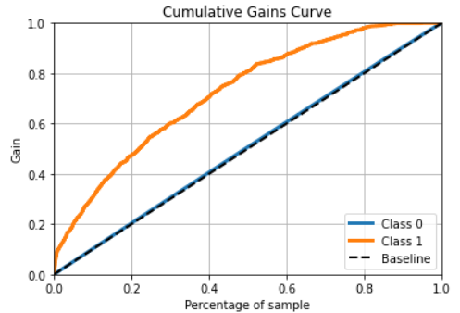
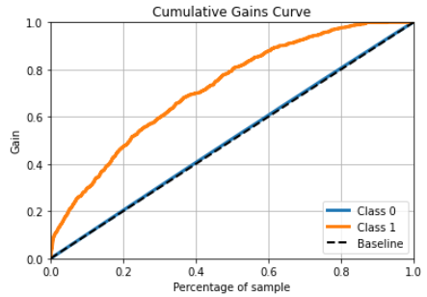
Provides Good Model Performance & Privacy
70%
Converting customers present in top 40% leads
70%
Converting customers present in top 40% leads
Real Data ROC: 0.729
Synthetic Data ROC: 0.725
No Data Privacy
Data Privacy: 81%

Slide 18
DataSynthesizer – Overall Evaluation
Bayesian Network based on GreedyBayes, maximizing Mutual Information
Network with 2 parents
Synthetic Data Evaluation
Actual Confirmation 5Y
Information Captured
Similar Clusters ✓
Similar Distributions ✓
Similar Correlations ✓
Model Utility
Good Model Performance ✓
Data Privacy
Relatively Decent Privacy
Ownership Segment
Confirmation 5Y
Confirmation 5Y
Inbound Product
Exchanges 3Y
Exchanges 3Y
WVR Confirmation 5Y
Synthetic Data may not follow all data constraints
Since features may not be connected directly in the network

Slide 19
Synthetic Data Generation
Gaussian Copula

Slide 20
About Gaussian Copula
Captures Probability Distributions between all feature combinations
Actual Confirmation 5Y
Marginal + Joint Probabilities: Captures all the possible independent and dependent relationships between the attributes of data
Manual Tuning: Need to determine the best fitting distribution for each feature
Confirmation 5Y
Ownership Segment
Confirmation 5Y
Joint Probability
Exchanges 3Y
WVR Confirmation 5Y
Allows for all data constraints
Exchanges 3Y
Inbound Product

Slide 21
About Gaussian Copula
Captures Probability Distributions between all feature combinations
Actual Confirmation 5Y
Probabilities between all feature combinations: Unlike DataSynthesizer which captures probabilities only between important features
Manual Tuning: Need to determine the best fitting distribution for each feature
Confirmation 5Y
Ownership Segment
Confirmation 5Y
Joint Probability
Exchanges 3Y
WVR Confirmation 5Y
Exchanges 3Y
Allows for all data constraints
Inbound Product

Slide 22
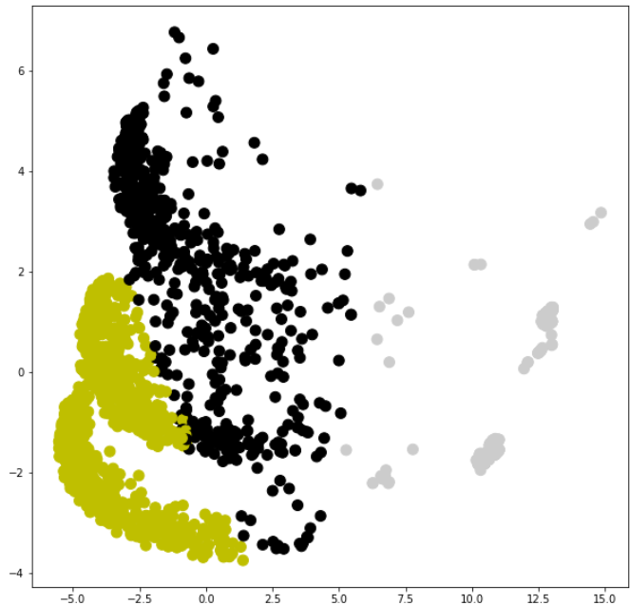
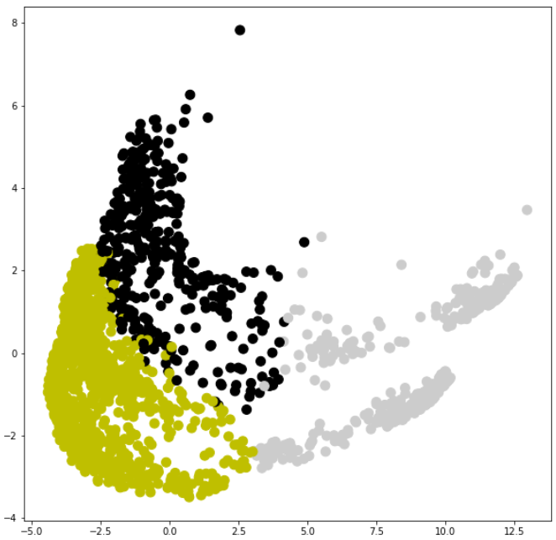
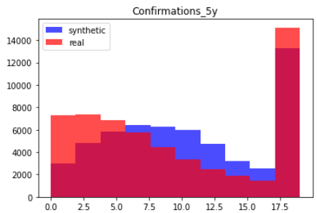
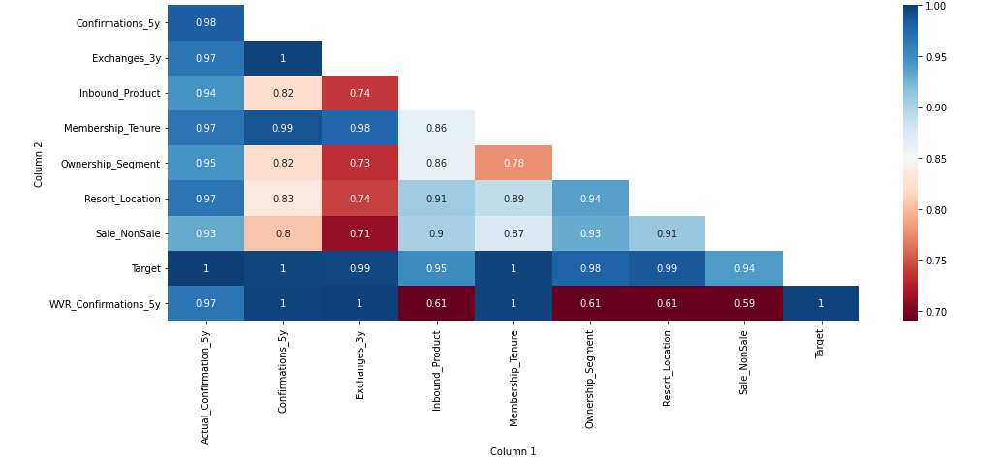
Effectively Captures Relevant Information
Cluster Comparison
Data Distribution
Correlation Comparison
Correlation Similarity
Significant Correlation
Real Data
Synthetic Data
Real vs Synthetic Distribution
Real vs Synthetic Correlation Similarity
Very similar clusters formed
Moderately Similar Univariate distributions Overall Similarity: 90%
Moderately Similar Correlations
Overall Similarity: 87%

Slide 23
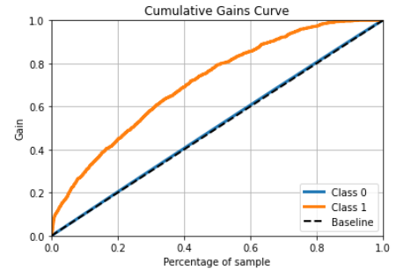
Higher Privacy For Minor Loss In Predictive Power
Offers higher privacy than DataSynthesizer for a 2% drop in opportunity coverage
70%
Converting customers present in top 40% leads
68%
Converting customers present in top 40% leads
Real Data ROC: 0.729
Synthetic Data ROC: 0.716
No Data Privacy
Data Privacy: 94%

Slide 24
Gaussian Copula – Overall Evaluation
Joint Probability Distributions between all feature combinations
Synthetic Data Evaluation
Actual Confirmation 5Y
Allows for all data constraints
Since all features are connected to each other
Confirmation 5Y
Information Captured
Similar Clusters ✓
Moderately Similar Distributions
Moderately Similar Correlations
Model Utility
Good Model Performance ✓
Data Privacy
Good Privacy ✓
Ownership Segment
Confirmation 5Y
Joint Probability
Exchanges 3Y
Exchanges 3Y
WVR Confirmation 5Y
Inbound Product
Manual Effort: Need to input type of distribution for each feature

Slide 25
Synthetic Data Generation
CTGAN

Slide 26
About CTGAN
Deep Learning based Adversarial Networks - Unsupervised Generator vs Discriminator modelling
Raw Data
Generator Model
Generates Synthetic Data
Real Sample
Discriminator Model
Classifies Synthetic Data as real or fake
Result
Update Model
Update Model
Allows for all data constraints
No need to input feature distributions

Slide 27
About CTGAN
Deep Learning based Adversarial Networks - Unsupervised Generator vs Discriminator modelling
Raw Data
Generator Model
Generates Synthetic Data
Real Sample
Iteratively tries to generate Synthetic Data that can not be discriminated from real data
Model stops after it is unable to discriminate with a certain threshold
Discriminator Model
Classifies Synthetic Data as real or fake
Result
Update Model
Update Model
Allows for all data constraints
No need to input feature distributions

Slide 28
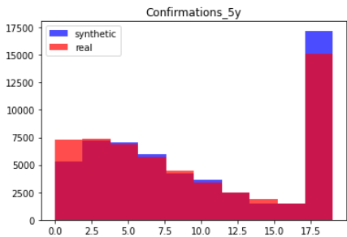
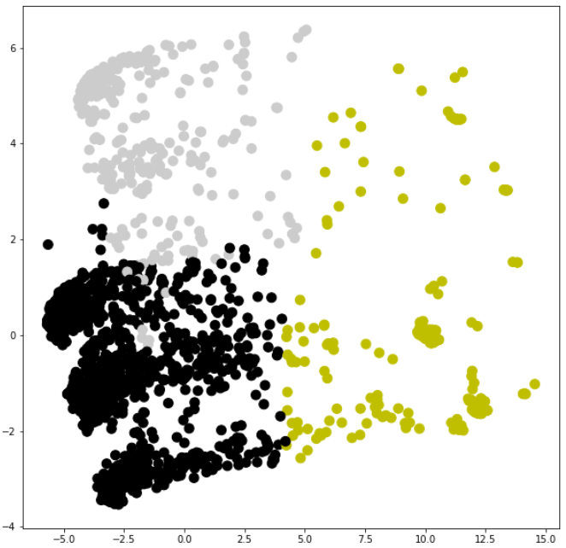
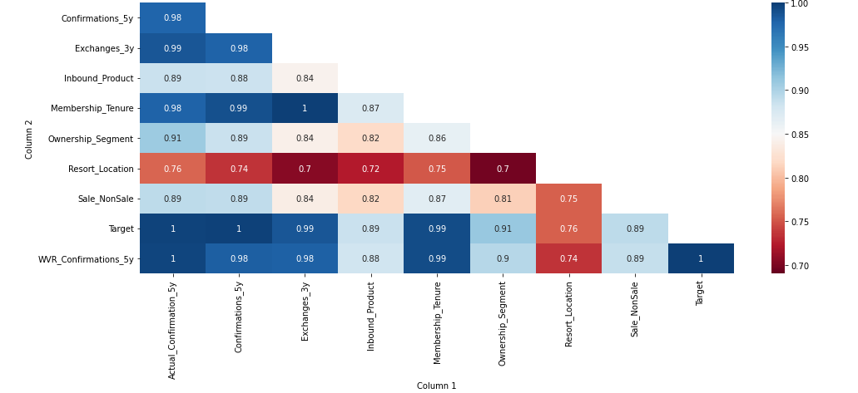
Does Not Capture Information Well
Cluster Comparison
Data Distribution
Correlation Comparison
Correlation Similarity
Significant Correlation
Real Data
Synthetic Data
Real vs Synthetic Distribution
Real vs Synthetic Correlation Similarity
Dissimilar clusters formed
Similar Univariate distributions
Overall Similarity: 92%
Moderately Similar Correlations
Overall Similarity: 88%

Slide 29
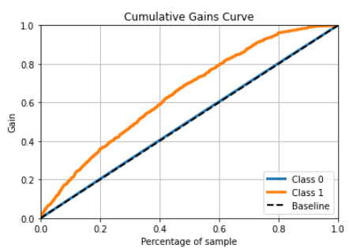
Poorest Model Performance for Least Privacy
Offers 78% data privacy for a 10% drop in opportunity coverage
70%
Converting customers present in top 40% leads
60%
Converting customers present in top 40% leads
Real Data ROC: 0.729
Synthetic Data ROC: 0.65
No Data Privacy
Data Privacy: 78%

Slide 30
CTGAN – Overall Evaluation
Deep Learning based General Adversarial Networks. Unsupervised Generator vs Discriminator modelling
Raw Data
Synthetic Data Evaluation
Allows for all data constraints
No need to input feature distributions
Generator Model
Generates Synthetic Data
Real Sample
Information Captured
Dissimilar Clusters
Similar Distributions ✓
Moderately Similar Correlations
Model Utility
Bad Model Performance
Data Privacy
Relatively Decent Privacy
Discriminator Model
Classifies Synthetic Data as real or fake
Result
Update Model
Update Model

Slide 31
Synthetic Data Generation
Recommendations

Slide 32
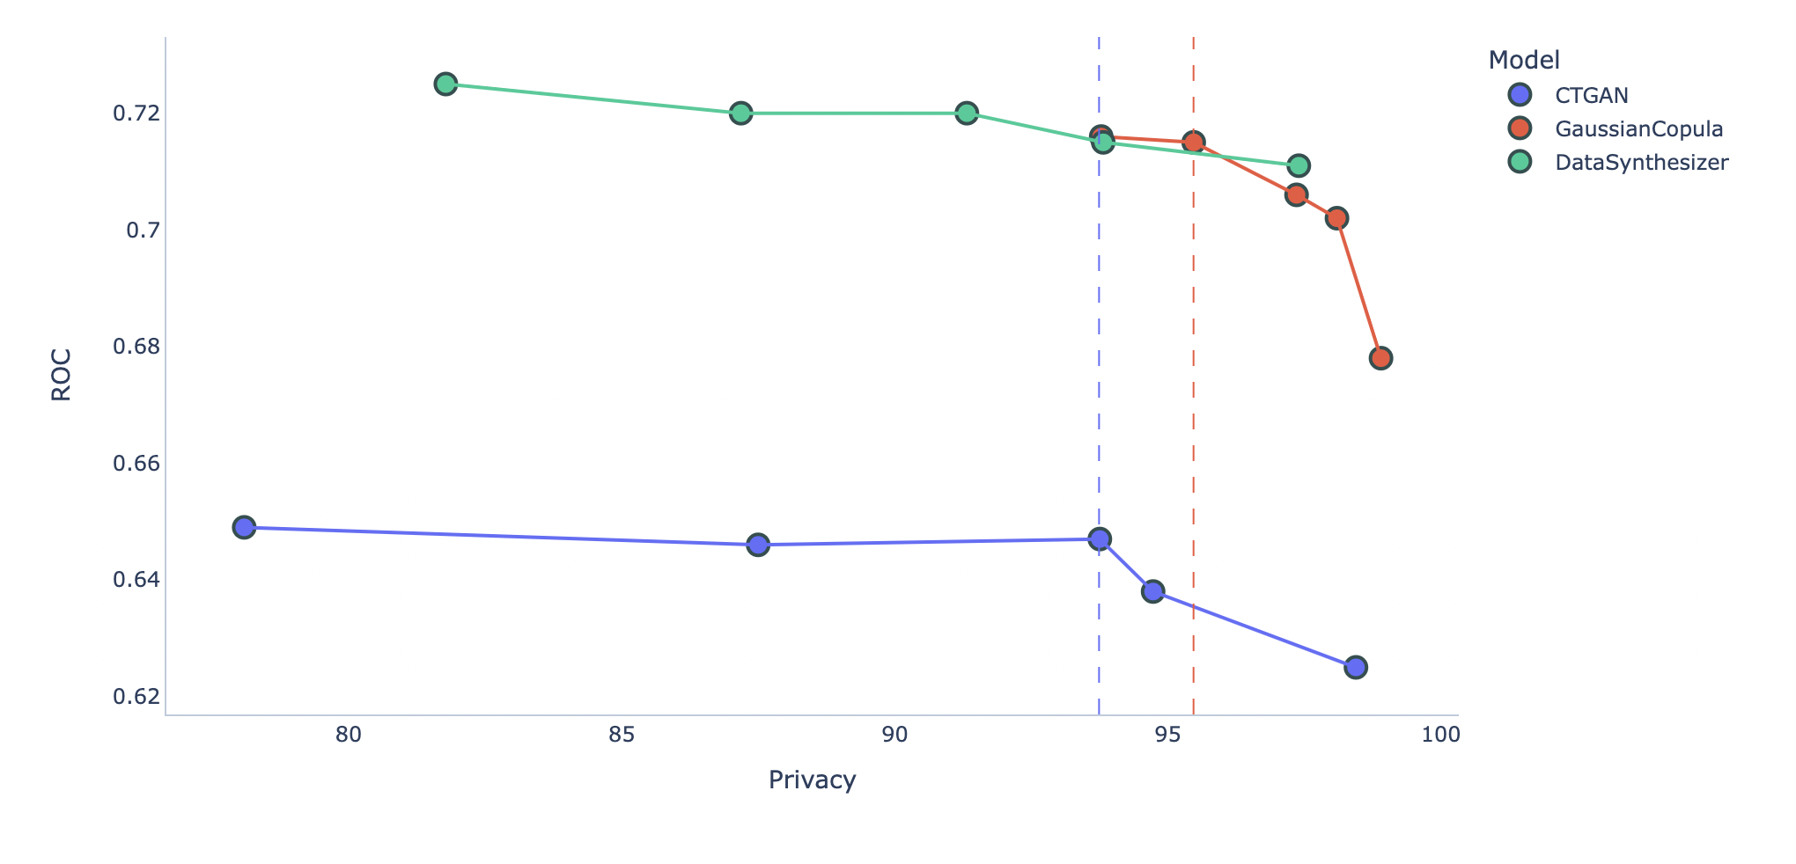
Adding Noise Increases Privacy, Decreases Model Performance
Model Evaluation Summary
Predictive Performance vs Noise
Model | Information Captured | Model ROC | Data Privacy
DataSynthesizer | Good | Good | Average
Gaussian Copula | Average | Good | Good
CTGAN | Bad | Bad | Average
Baseline Models
How to further increase data privacy?
By adding disturbances to the synthetic data in the form of Laplace noise
As we add noise, privacy increases for a drop in model performance

Slide 33
Recommendations
Predictive Performance vs Noise
Which approach to choose?
Real Data
Priority | DataSynthesizer | Gaussian Copula | CTGAN
Model Performance as close to real data | ✓
High privacy and good performance | ✓ | ✓
Data has many features/columns | ✓
Adhering to data constraints is important |  | ✓
Large Dataset | ✓ |  | ✓
Best Model Performance
DataSynthesizer and Gaussian Copula perform similar for high privacy
Big drop in performance for incremental privacy
Choice depends on business objectives and priorities

Slide 34
Next Steps
Share codes and documentation
1
Create modularized codes and pipeline to share with the T&L team
Explore the use of synthetic data to fix class imbalance
2
Use synthetic data for oversampling and record model performance improvement if any
Book our post graduation trip with Travel + Leisure
3
And hopefully get a discount

Slide 35
Thank You

Slide 36
Appendix

Slide 37




Clustering Approach
Why clustering?
To compare the similarity between real data and the synthetic data How? : Create clusters based on real data as well as synthetic data and compare cluster characteristics between the two sets to assess quality of synthetic data.
Data preprocessing
Gower distance: Measure of dissimilarity between data points.
Dummy Variables: One-hot-encoding categorical variables.
Clustering
Clustering techniques applied
Explored distribution and density-based clustering algorithms (KMeans, KPrototype, Gaussian Mixture, Hierarchical, BIRCH, Spectral Clustering)
Best Algorithms
Based on Euclidean distance between clusters formed.
(Higher distance = Better separation between clusters) Best algorithm: KMeans & Gaussian Mixture (Using Gower distances)

Slide 38



Reasons for Mitigating Data Privacy Risks
81% of Americans say that they feel they have little or no control over the data that is collected about them by companies. [Pew Research Center, 2020]
Average cost of a data breach in the United States was $8.64 million and the average time to identify and contain a data breach was 280 days. [Ponemon Institute, 2020]
Solution: Synthetic Data

Slide 39
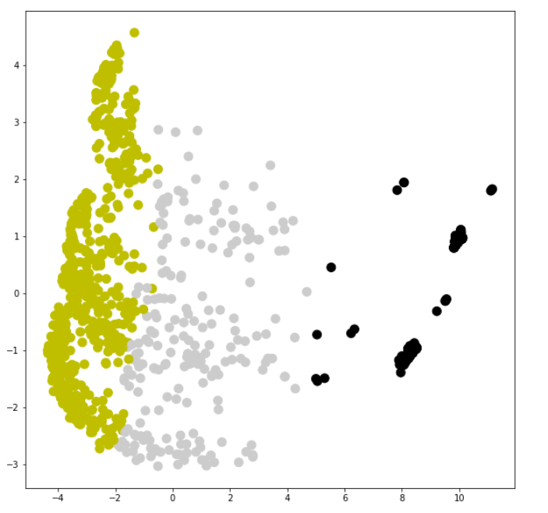
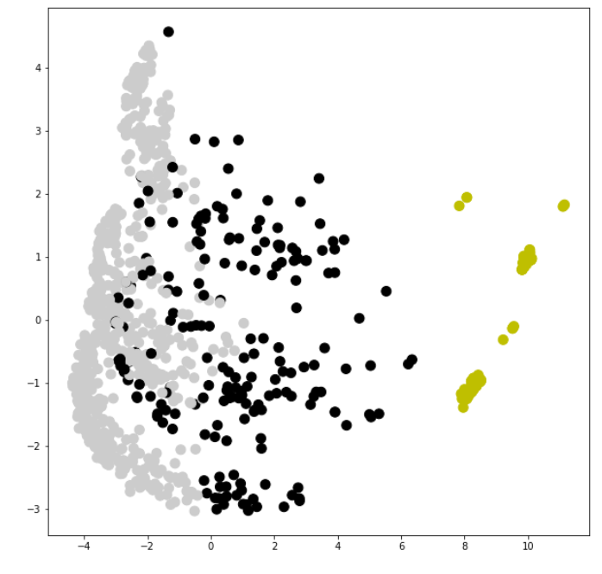
Clustering Results - Actual Data
K-Means Clustering
Euclidean cluster distance: 26.8
Using Gower distances as inputs
Gaussian Mixture Models Clustering
Euclidean cluster distance: 26.4
Using Gower distances as inputs

Slide 40
Clustering Results - Actual Data
Cluster Characteristics
Cluster | A | B | C
Membership Tenure | - | Low (-49%) | High (+102%)
Confirmation and Exchanges | Low (-56%) | High (+92%) | -
Products with High/Low proportion | Exchange – Points (+74%) | Rental (+88%) | Exchange – Weeks (+23%) Exchange – Points (-69%)
Site | - | - | Non Sale (+23%)
Ownership Segment | P (+42%) C(+100%) | O (+252%) W (-72%) | W (111%) P (-54%) C (-88%)
Resort Location | Hawaii (+31%) | Central Florida (+56%) Hawaii (-51%) | -
High (% Above Mean)
Low (% Below Mean)

Slide 41
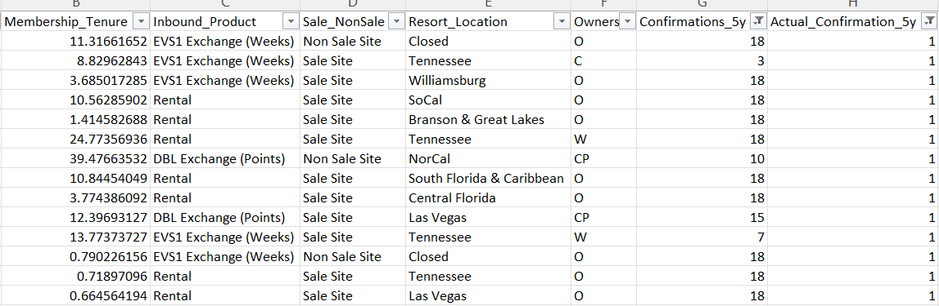
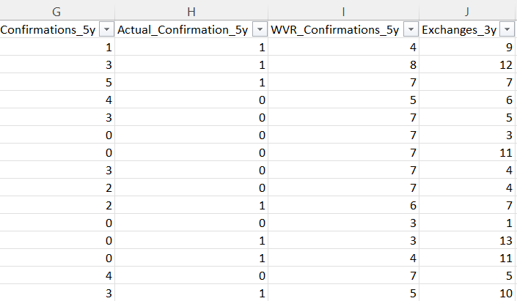
Synthetic Data Simulations – Business Validation
Synthetic Data must be similar in characteristics to real data and must also follow all business constraints
Constraint 1
Constraint 2
Actual_Confirmation_5y -> 1 only when Confirmation_5y > 1000
Confirmations_5y must be greater than or equal to WVR_Confirmations_5y & Exchanges_3y
Current Synthetic Data generator fails to adhere to the two constraints mentioned
Solution: Synthetic Data Vault (SDV)

Slide 42
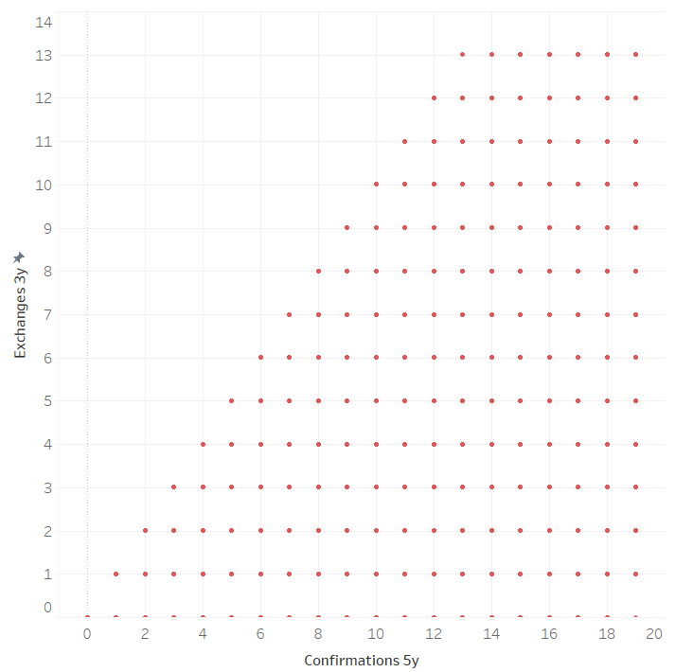
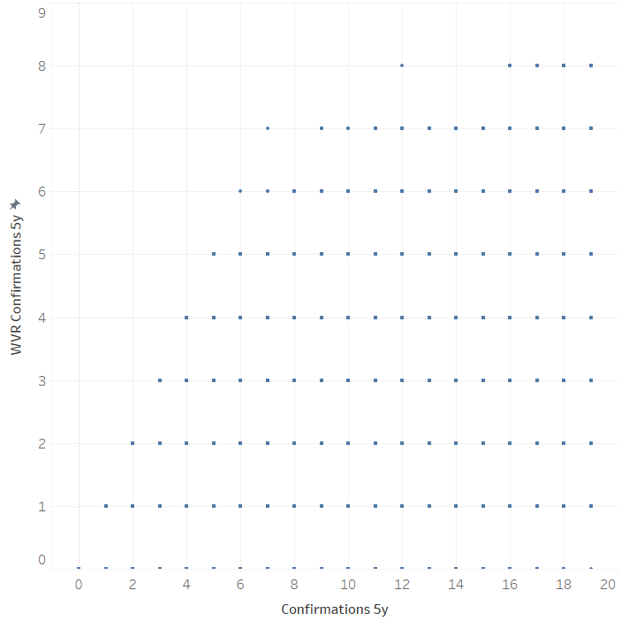
Synthetic Data Vault – Business Constraints Validation
Confirmations_5y must be greater than or equal to WVR_Confirmations_5y & Exchanges_3y
Constraint is followed

Slide 43
Validation- Actual Confirmation 5 Years, Confirmation 5 Years
Actual_Confirmation_5y -> 1 only when Confirmation_5y > 1000
Constraint is followed

Slide 44
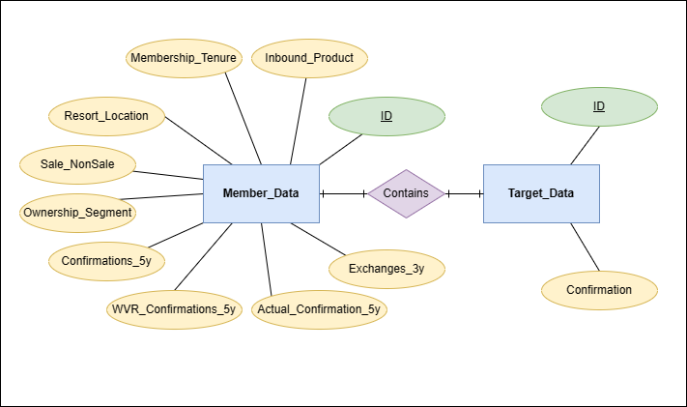
Entity Relationship Diagram

Slide 45
Data Dictionary
Member Data
Columns | Description | Data Type | Comments
ID | Unique ID of Inbound | Integer | Randomly generated
Membership_Tenure | Duration of membership | Float
Inbound_Product | Product used for Inbound | String
Sale_NonSale | Sale vs Non-Sale resort site | String
Resort_Location | Classification of resort's geographical location | String
Ownership_Segment | Member's ownership segment | String
Confirmations_5y | Confirmations over 5 years | Integer | Capped at 19 (For Company members)
Actual_Confirmation_5y | Actual confirmation over 5 years | Binary | Indicates if member had more than 1000 confirmations
WVR_Confirmations_5y | Confirmations to WVR over 5 years | Integer | Capped at 8 (For Company members)
Exchanges_3y | Exchanges over 3 years | Integer | Capped at 13 (For Company members)
Target Data
Columns | Description | Data Type | Comments
ID | Unique ID of Inbound | Integer | Randomly generated
Confirmation | If member confirmed | Binary | Target variable

Slide 46
Data Summary
2
#Datasets
Member data (Input features)
Confirmation (Target variables)
56K
Rows of data
Member level
60% of actual data
10
Columns in data
Membership and historic transactions
Feature Summary
13
Years
Average
Membership
Duration
16
Resort Geographies
9
Ownership Segments
3
Inbound Products

Slide 47
Inbound Products Overview
Distribution of Members and Tenure across Inbound Products
Key Insights
69% Members opt for Weekly Exchanges
Members with weekly exchanges have had the highest tenure

Slide 48
Resort Geography Overview
Distribution of Members and Tenure across Resort Geographies
Key Insights
Tennessee, Central Florida, Las Vegas and Williamsburg resorts account for 41% members
Las Vegas, Central Florida and Williamsburg resort members have had relatively smaller tenures

Slide 49
Resort Site Overview
Distribution of Members and Tenure across Sale/ NonSale Site
Key Insights
93% members have memberships in sale sites
Non sale site members have a much higher tenure

Slide 50
Resort Ownership Overview
Distribution of Members and Tenure across Ownership Segments
Key Insights
W, P, O, C ownership segments account for 95% members
CPW, CW, PW and W ownership segments have a relatively higher tenure than the rest

Slide 51
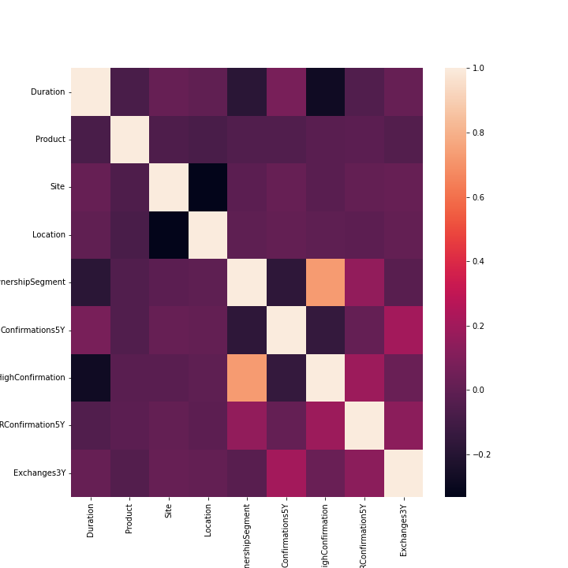
Feature Correlations
Key Insight
Ownership_Segment and High_Confirmation have a high linear correlation
Note: Categorical variables have been factorized to calculate Pearson correlation values.

Slide 52
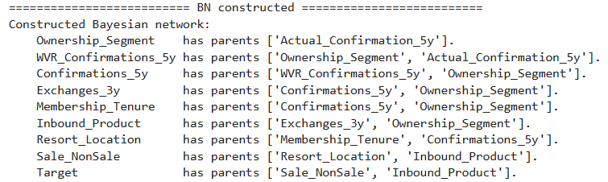
Bayesian Network – Data Synthesizer

Slide 53
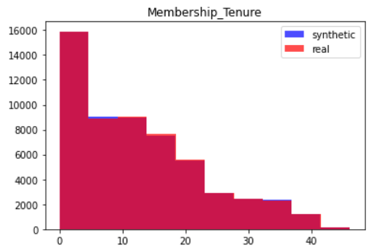
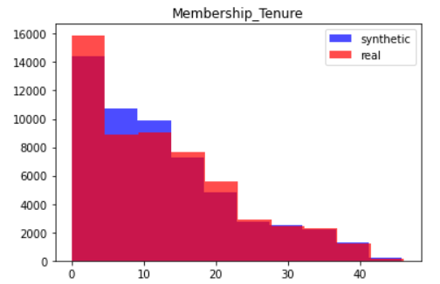
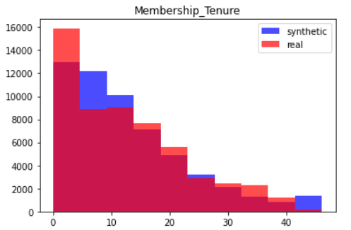
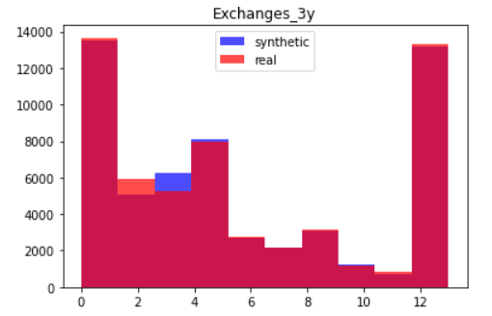
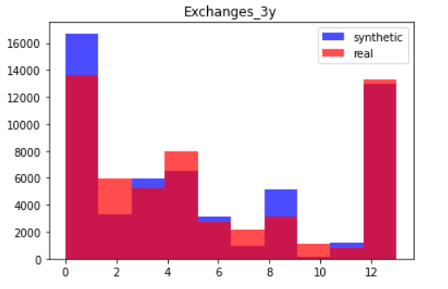
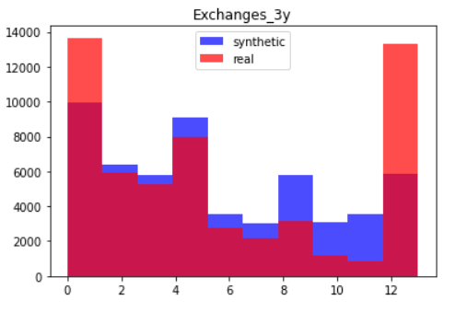
Synthetic Data Simulations - Univariate Distributions Comparison
Data Synthesizer
CTGAN
Gaussian Copula

Slide 54
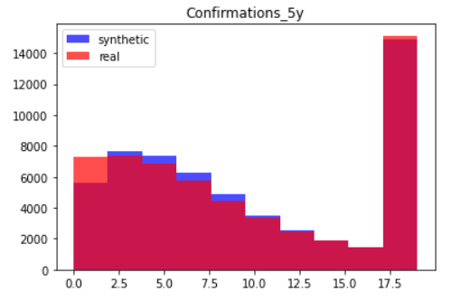
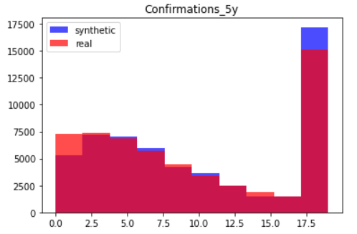
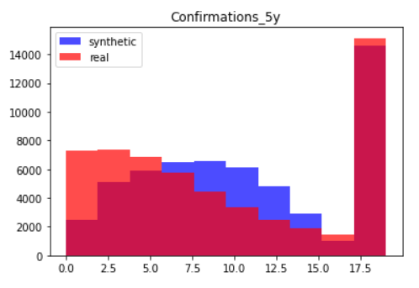
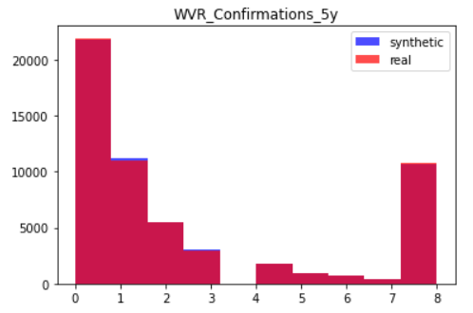
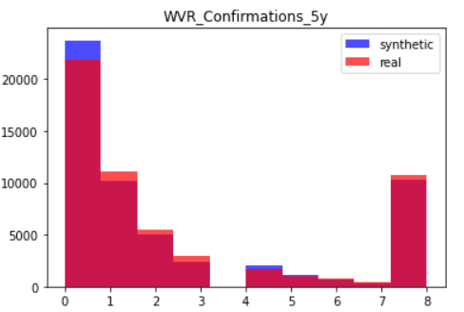
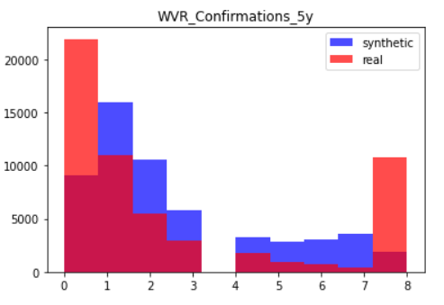
Synthetic Data Simulations - Univariate Distributions Comparison
Data Synthesizer
CTGAN
Gaussian Copula

Slide 55
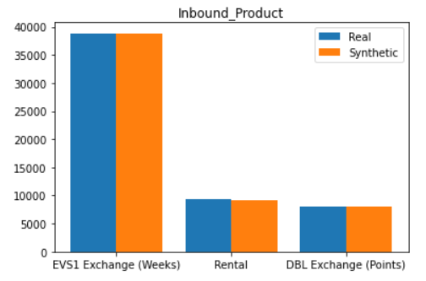
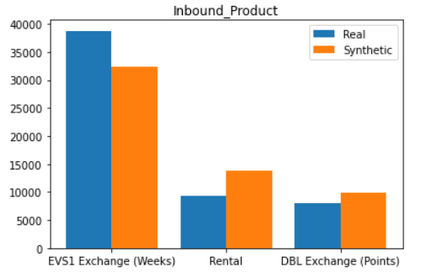
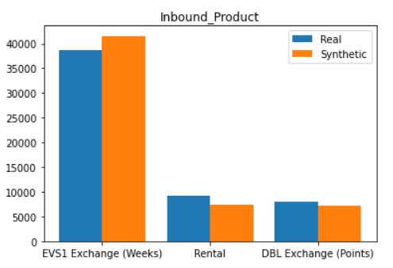
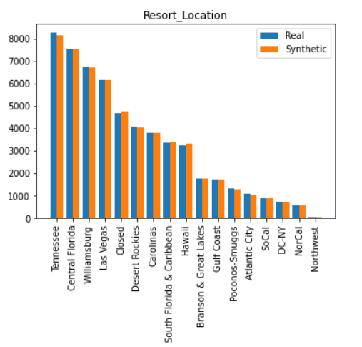
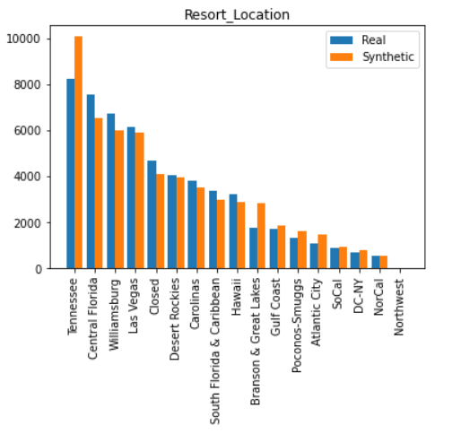
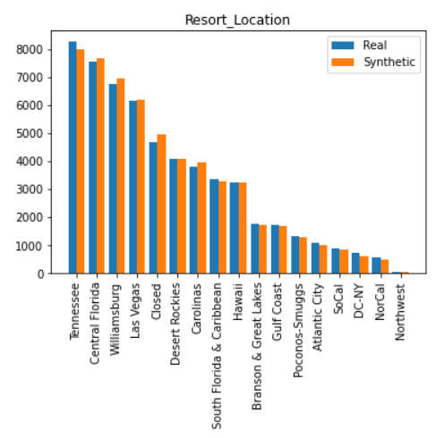
Synthetic Data Simulations - Univariate Distributions Comparison
Data Synthesizer
CTGAN
Gaussian Copula

Slide 56
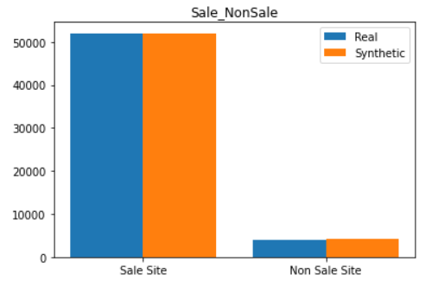
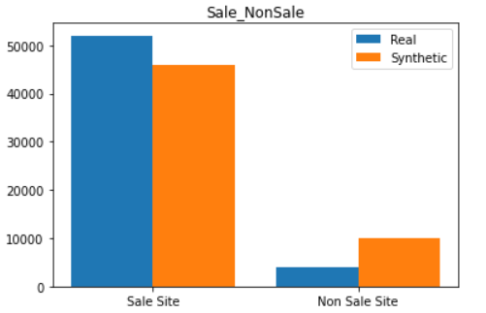
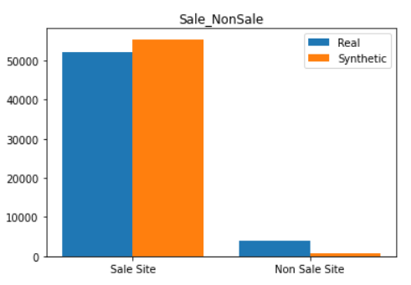



Synthetic Data Simulations - Univariate Distributions Comparison
Data Synthesizer
CTGAN
Gaussian Copula

Slide 57
Thank You

